Slide 1
BLACKOUT POETRY
Created by Kristen Badger

Slide 2
The great thing about poetry is that is has no rules! You can do anything you want in a poem. It does not have to have correct cApiTALizatiOn or- punctuation’..”! AnYtHing goEs!.!.!.!
A blackout poem is a type of poem created using a page from an old book. Words on the page are highlighted or left uncovered to create a poem.
A blackout poem is about finding words on the page to create a poem.
A blackout poem can be artistic and decorative or simple and straightforward.
Here are some examples from students…..

Slide 3
The men got to their feet
Faces identically glum
Silent
It was too late
A few words of sorrow
Anger
Anguished disbelief
There will not be a next time

Slide 4
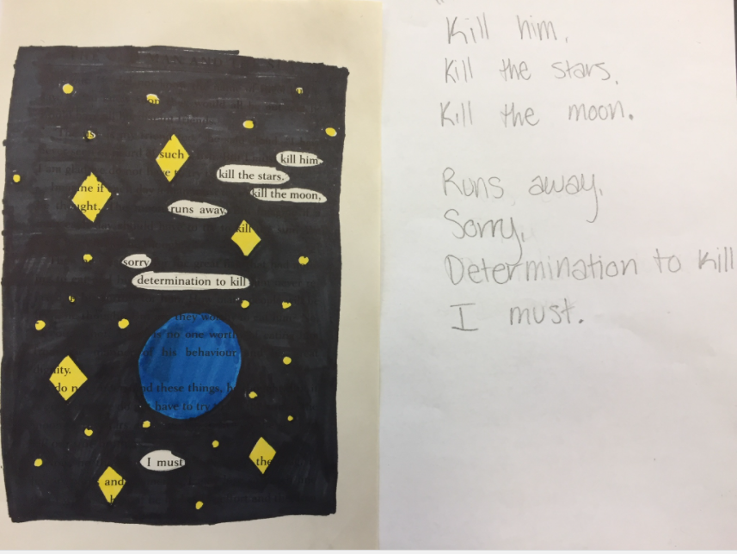

Slide 5
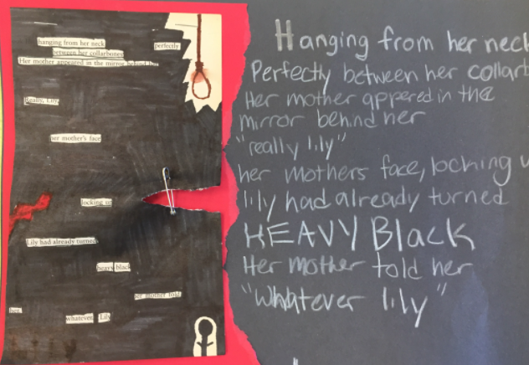

Slide 6
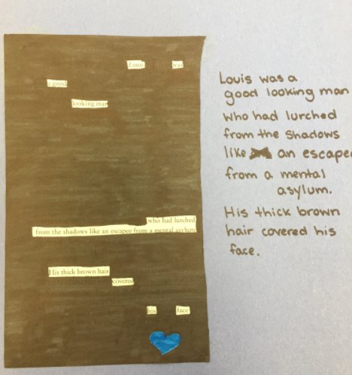

Slide 7
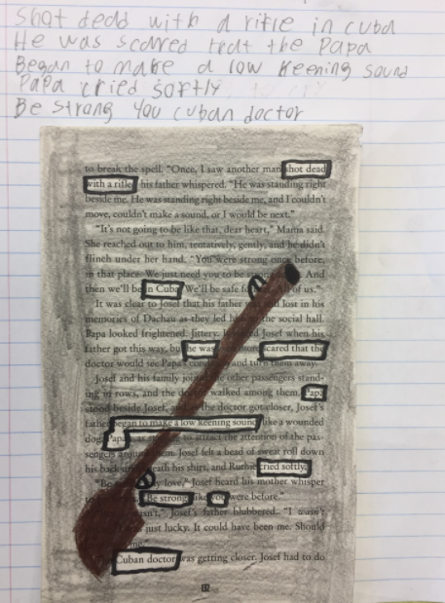

Slide 8
Window
Broken
Still a long way
Came

Slide 9
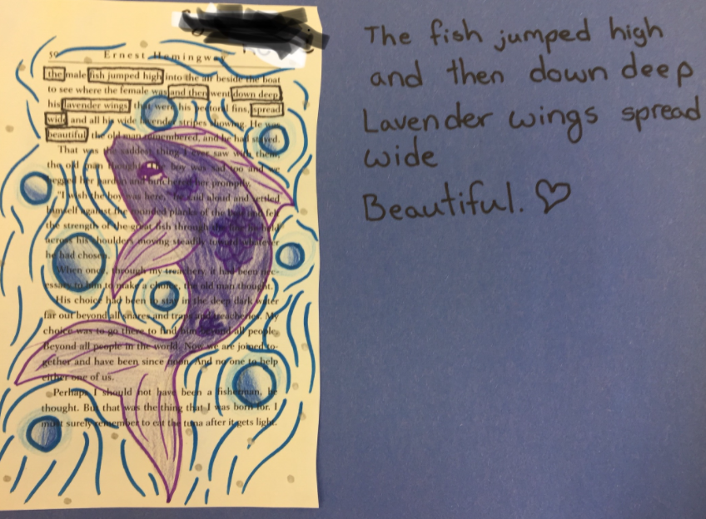

Slide 10
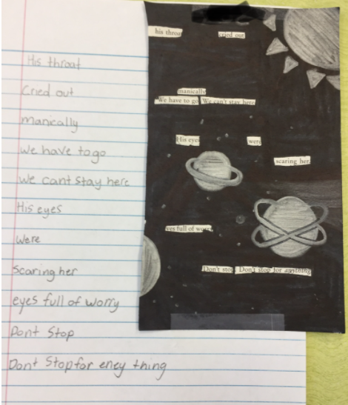

Slide 11
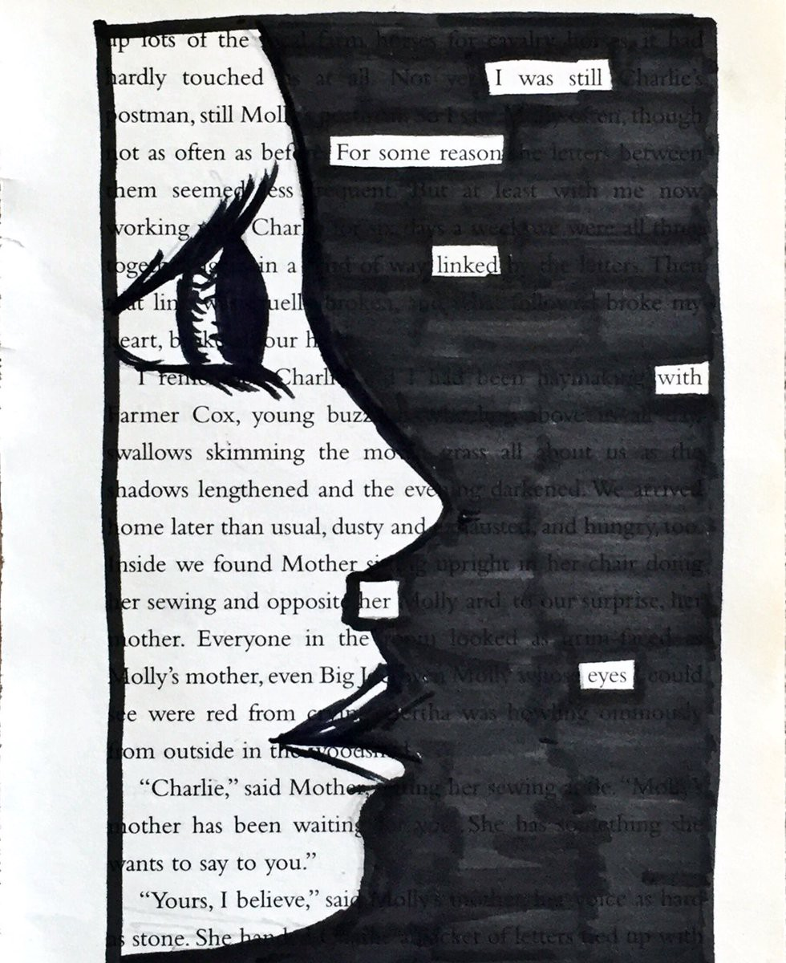

Slide 12
Instructions
Skim your page of words.
Go through and lightly circle the words or phrases you might want to use.
Grab a blank piece of paper and write them down in order, then read through them.
Cross out the words you don't want.
If you need a few connecting words (like "a", "the", "it", etc.) then dive back in and see if you can find them between the words you want to connect. You often can.
Go back through your poem and boldly box the words you are keeping with pen, sharpie, dark pencil, etc. Erase any circles around words you don't want.
Read through your final poem. Sketch in a few images or symbols on your page that relate to the theme of your poem. Now it's time to start blackening or coloring. Using a sharpie, pen, or pencil, black out or color over everything that is NOT a word in your poem or one of your own sketches.
Attach your book page to a piece of paper (using glue or tape).
Write your poem in the space next to the attached. book page.

Slide 13
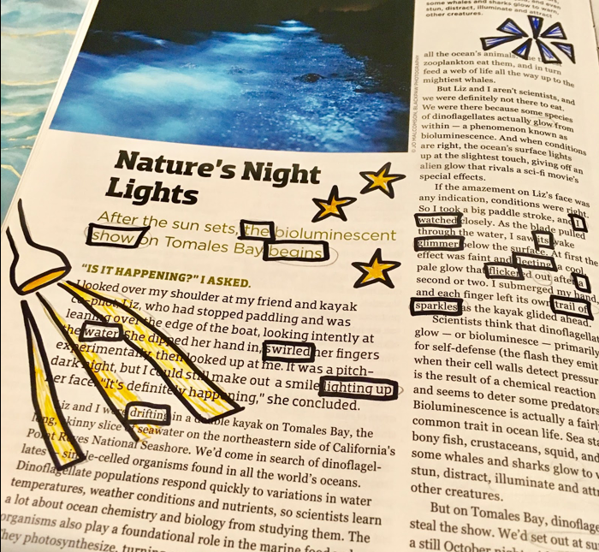
Poem in progress

Slide 14
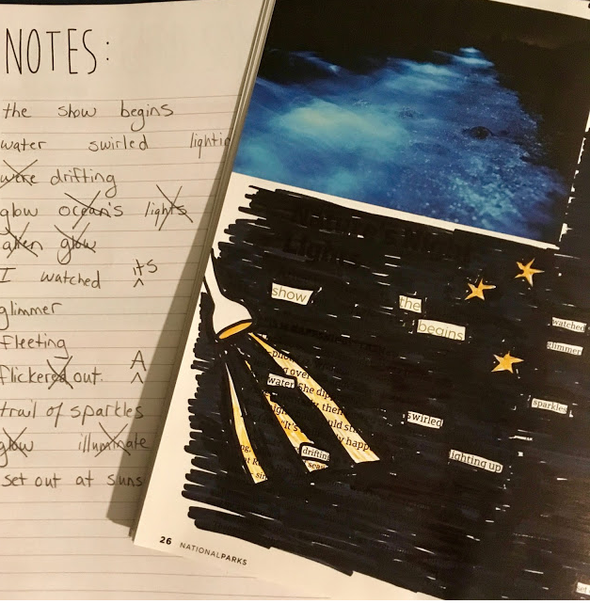
Completed poem
The show begins. Water swirled lighting up drifting glow. I watched its glimmer fleeting flicker out. A trail of sparkles set out at sunset.

